Slide 1


Detection of Malaria in Red Blood Cells using Deep Learning
Abhinav Ram Mohan
MIT ADSP – December 2022

Slide 2
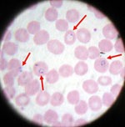
Scope of the Problem
Malaria is a parasitic infection (plasmodium) of the red blood cells that results in nervous system shutdown and respiratory distress
In 2019 alone, there were more than 229M cases of malaria with 400K reported deaths globally
Traditionally, this disease is diagnosed through microscopy analysis of blood smear

Slide 3
Addressing a Tedious Task
The current evaluation of blood smear manually comes with the following issues:
Prolonged time for diagnosis
Increased overhead cost for analyst
Understanding these limitations of traditional diagnosis, how can deep learning be used to evaluate plasmodium infected cells?

Slide 4
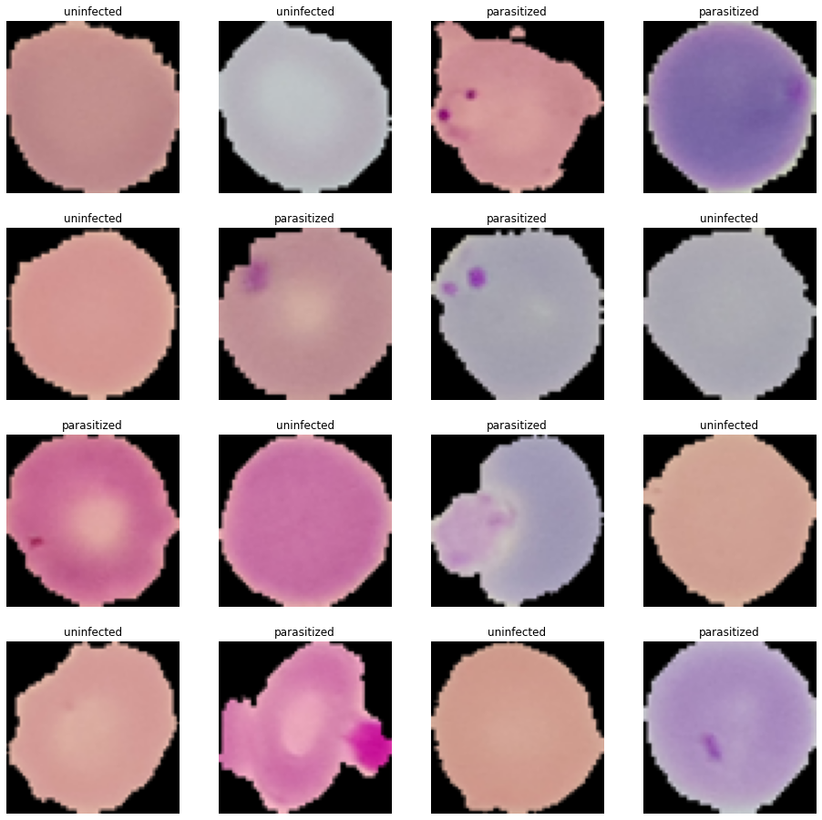
Approach and Methodology
Key takeaways from data exploration and visualization
The data is a set of images that are either infected or uninfected by plasmodium
Observe how coloration of the malarial infection is similar to that of uninfected cells as well – as a result potential misclassification issues could arise
Image pre-processing required
Status | Training | Testing
Infected | 12582 | 1300
Uninfected | 12376 | 1300

Slide 5
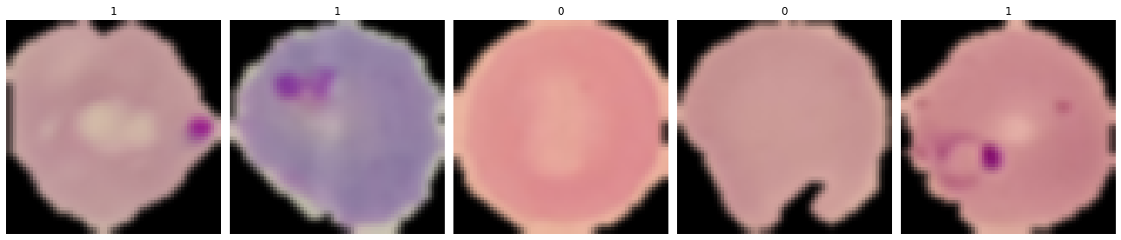
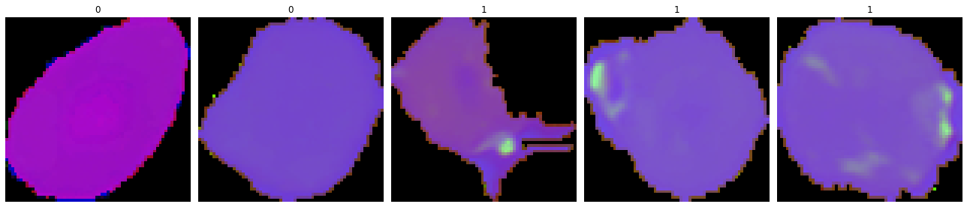
Data Visualization
How can we process the images so that they are suitable for analysis by the DL algorithms?
The uninfected cells can have the same hue/saturation as the infected portions of parasitized cells – confounding factors if the elements given as “ground truths” have similar features
Original Data
Gaussian blurring is used to normalize pixel intensities across the images so that stark boundary changes are smoothened
Gaussian Blurring
As part of the “ground truths” segmentation, we identify the green colorations as parasitic – Thus we label images having this green coloration inside the cells as “parasitized”
Images converted to HSV (Hue, Saturation, Value)

Slide 6
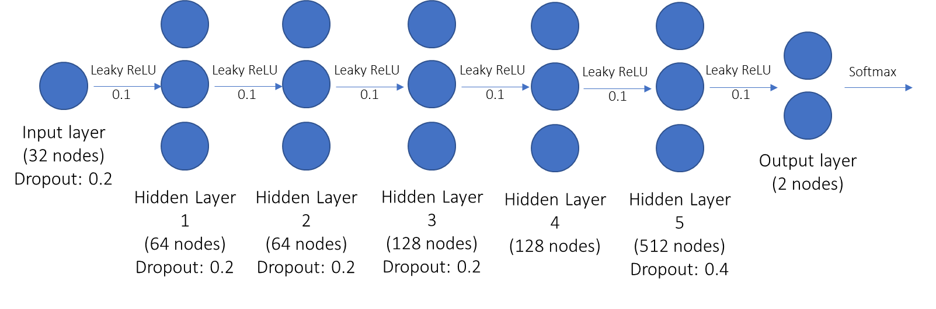
Proposed Model Architecture
The following is the proposed final model architecture
Input data: Augmented set of HSV converted images and labels of plasmodium infected and uninfected cells
Expected output: classification of plasmodium infected cells
Logic behind multiple layers: classification of images through key features
Images have multiple features in common: Black background, shape of the cells, and general cytoplasmic stain after conversion to HSV
Differentiating factor is the green plasmodium stain

Slide 7
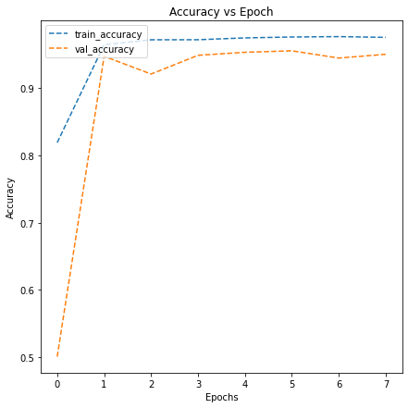
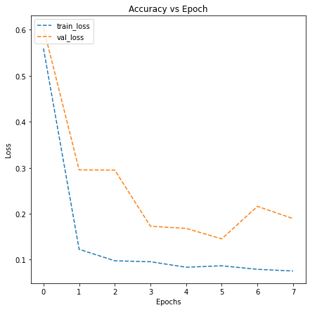
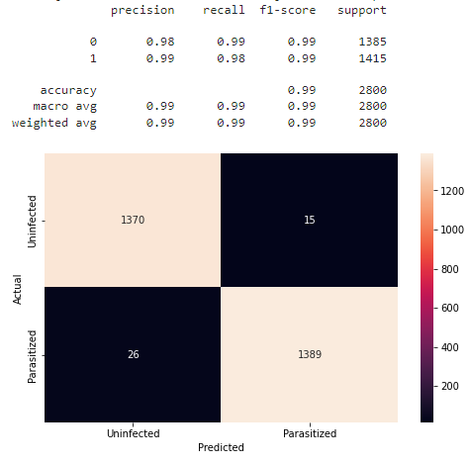
Model Outcomes
Loss relatively higher than during testing
Accuracy relatively lower than during testing
Model had an accuracy of 98.5% on the testing dataset
F1-score of 0.99 and MCC of 0.97 (value of 1 indicates no misclassification)
Loss value of 0.0452 (value of 0 indicates no loss – model works great!)
Model was able to classify majority of the plasmodium infected and uninfected cells with a high accuracy (97.8% of uninfected and 99.2% of infected correctly classified)
Helpful in the diagnosis of malaria – expedite diagnosis through automation

Slide 8
Translation of the idea into a business solution
Automation of such a task can be used in a multitude of cases:
Any work involving analysis of cells can be automated in this manner
Cut overhead cost in the clinical setting for an additional analyst
Parallel workflows for mass data analysis at a more rapid rate
Example use-cases for such automations using Deep Learning and CNNs:
Classifying cancer cells
Identifying the degree and nature of fibrotic tissues for lung and kidney fibrosis
Cloud infrastructure and systems being more and more utilized in the healthcare settings; many come with ML Ops that can be utilized

Slide 9
Future of ML Ops in Healthcare
Understanding setbacks due to HIPAA regulations and patient data privacy
Momentum to move towards data anonymity for population data analysis
Cross-identification of patients by tags than identifying info such as name, DOB, etc if information not necessary for data analysis
Scope for many models to be used for different applications
Example in the case of image analysis can use different algorithms such as YOLO (you only look once) for real time object detection (i.e. when looking at cell immunogenicity or reactivity towards an antigen)

Slide 10
Final Comments
Deep learning using CNNs are useful for gaining insights from histological (microscopic) data
Greatly benefit the advancement of science and research through large-scale data analysis
Over time, algorithms that are developed may have multiple uses for multiple applications
Many applications in R&D in clinical settings, academia and biotech industries

Slide 11
Thank You!

Slide 12
Appendix

Slide 13
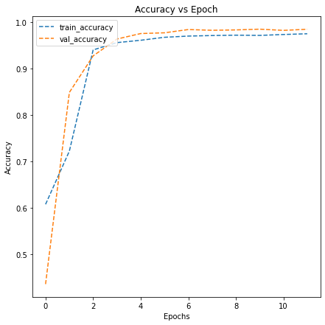
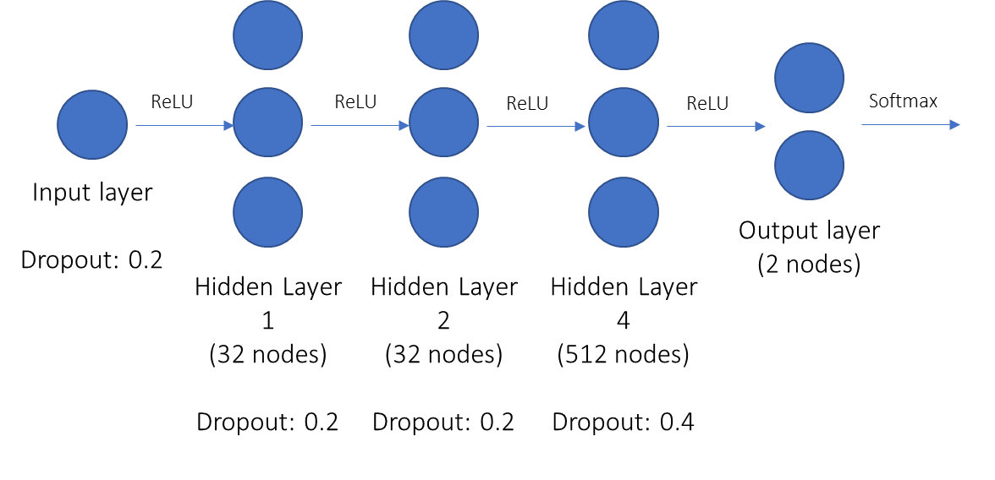
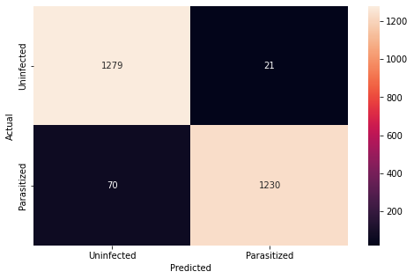
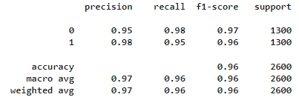
Base Model
Architecture
Outcomes:
From the base model, the model has an accuracy of 96.5%, with a precision on average of 0.97, recall of 0.96 and an f1-score of 0.96.
Of the 1300 images of each class, 21 uninfected are classified incorrectly and 70 parasitized are classified incorrectly
The validation accuracy and training accuracy approach a plateau; increasing epochs beyond this point may not be beneficial to the model. The validation accuracy is slightly higher than the training accuracy and this can be potentially attributed to dropout, where the model may be more robust to the testing data, since the behaviors of the two datasets are different
Model Accuracy: 96.5%

Slide 14
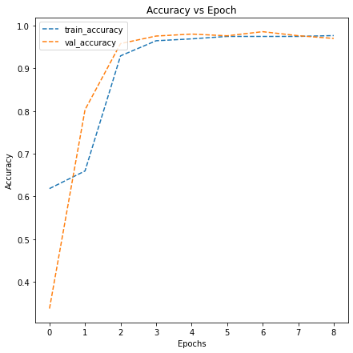
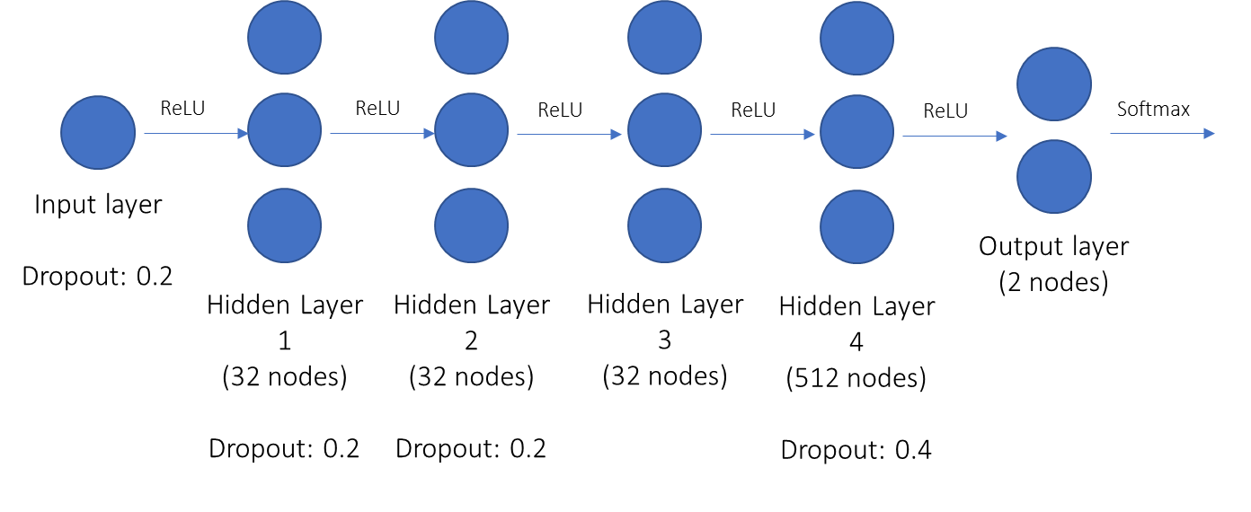
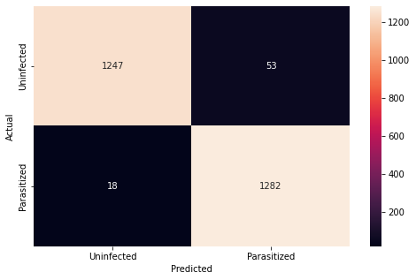
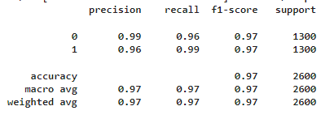
Model 1 – One Additional Layer
Architecture
Outcomes:
Model 1 has a precision on average of 0.97, recall of 0.97 and an f1-score of 0.97.
Of the 1300 images of each class, 53 uninfected are classified incorrectly and 18 parasitized are classified incorrectly
The validation accuracy and training accuracy approach a plateau very close to each other; increasing epochs beyond this point may not be beneficial to the model. The validation accuracy starts higher than the training accuracy, which may be due to the additional layer and dropout adding robustness to the model. However, this quickly fades with increasing epochs where the training and validation accuracies quickly even out. The increased f1-score indicates a better performance than the base model
Model Accuracy: 97.3%

Slide 15
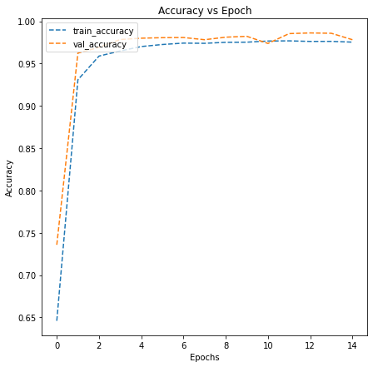
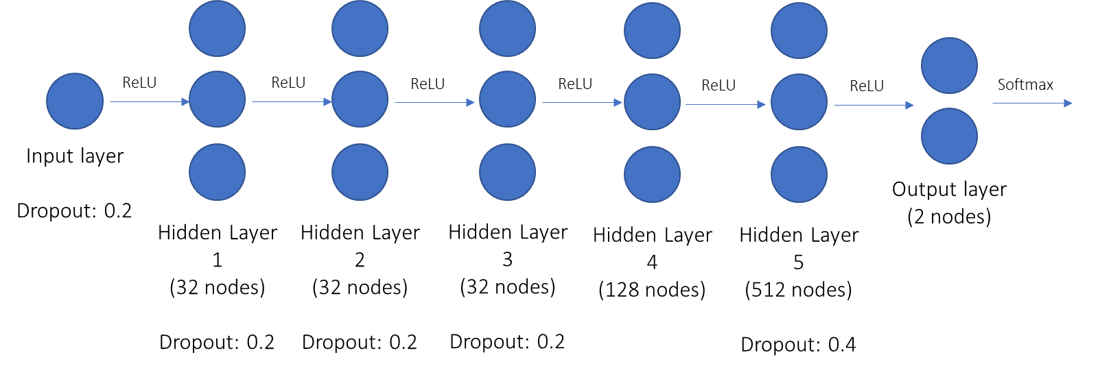
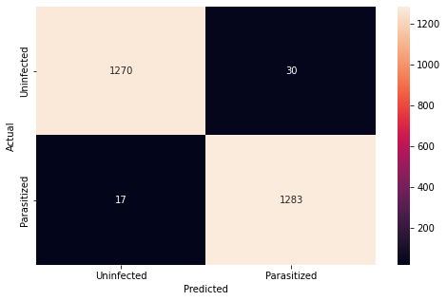
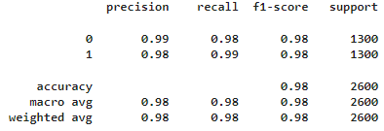
Model 1_2 – 2 Additional Layers
Architecture
Outcomes:
Model 1_2 has a precision on average of 0.98, recall of 0.98 and an f1-score of 0.98.
Of the 1300 images of each class, 30 uninfected are classified incorrectly and 17 parasitized are classified incorrectly
The validation accuracy and training accuracy approach a plateau very close to each other. The validation accuracy starts higher than the training accuracy, which may be due to the additional layer and dropout adding robustness to the model. However, this quickly fades with increasing epochs where the training and validation accuracies quickly even out. The increased f1-score indicates a better performance than the base model as well as Model 1, indicating that the increase in model complexity may contribute to feature extraction and identification to improve image classification
Model Accuracy: 98.2%

Slide 16
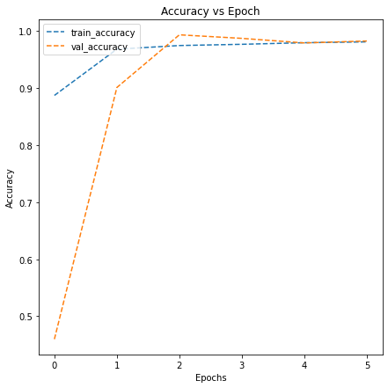
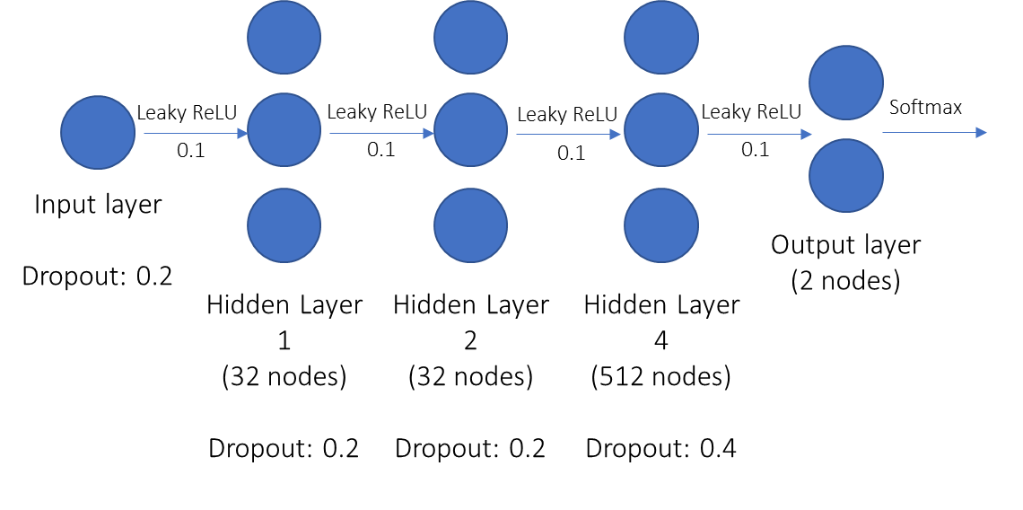

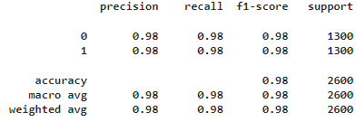
Model 2 – Leaky ReLU and Batch Normalization
Architecture
Outcomes:
This model is very similar to the Base Model, except that the activation functions for the hidden layers are replaced with leaky ReLU and there is batch normalization after pooling each layer; the model has an accuracy of 98%, with a precision on average of 0.98, recall of 0.98 and an f1-score of 0.98.
Of the 1300 images of each class, 26 uninfected are classified incorrectly and 26 parasitized are classified incorrectly
Initially, the validation accuracy is lower than the training accuracy, however as the number of epochs increases, the validation and training accuracies come to align with each other. Considering the architecture is essentially the same as the Base Model, having leaky ReLU and batch normalization improved the performance of the CNN
Model Accuracy: 98%

Slide 17
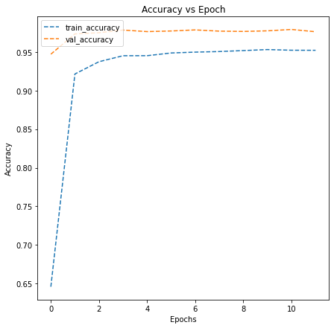
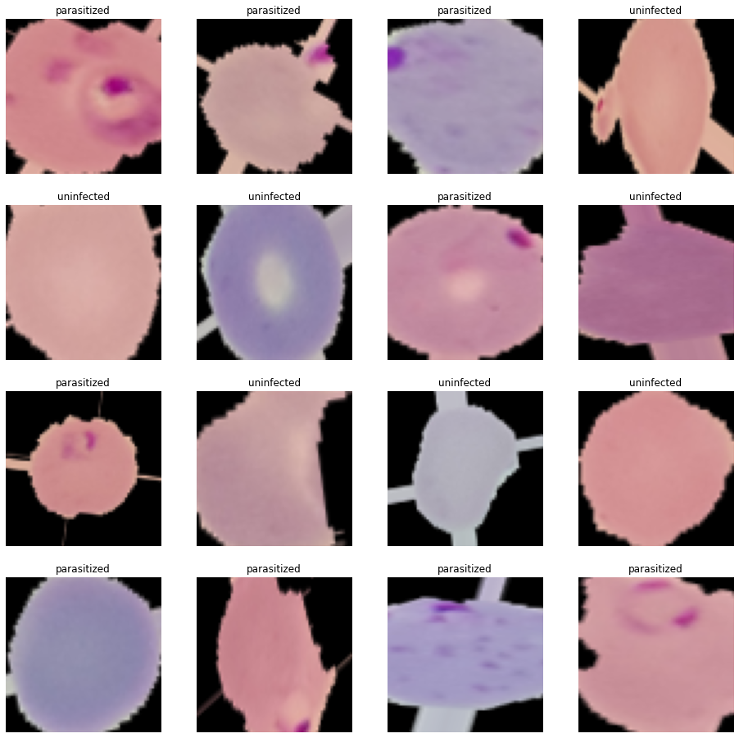
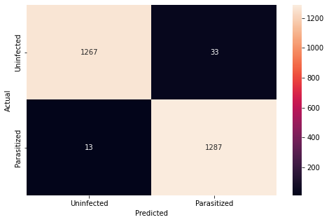
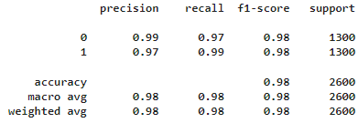
Model 3 – Data Augmentation
Architecture
Outcomes:
Images were stretched, shrunk, rotated
The CNN used is the same as Model 1_2; the purpose was to test effects of data augmentation. The model has an accuracy of 98.2%, with a precision on average of 0.98, recall of 0.98 and an f1-score of 0.98.
Of the 1300 images of each class, 33 uninfected are classified incorrectly and 13 parasitized are classified incorrectly
Throughout this model, the validation accuracy stays higher and relatively constant compared to the training accuracy. This could be due to the implementation of dropout as well as dataset augmentation. Note, however, that the accuracy and f1-score of the model does not change. This could mean that right away, the model reaches its peak accuracy and the number of epochs may not play a significant factor due to the dataset augmentation (i.e., model robustness is potentially increased)
Model Accuracy: 98.2%

Slide 18
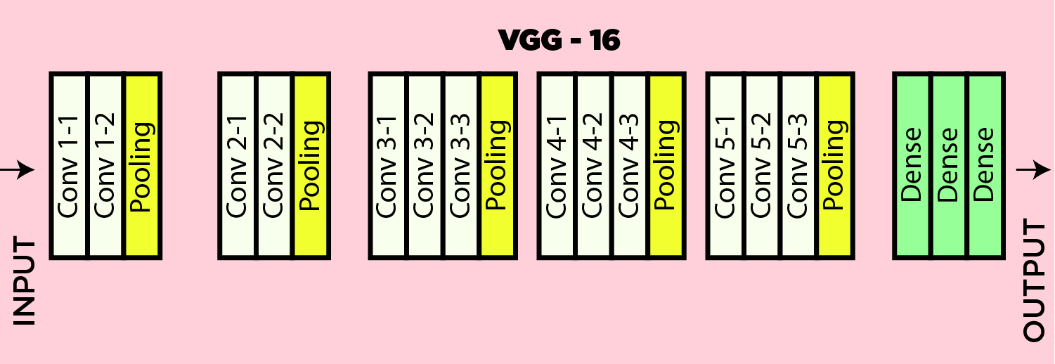
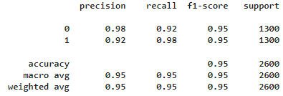
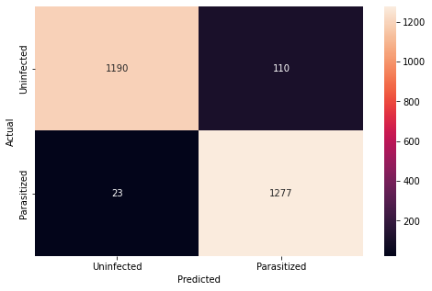
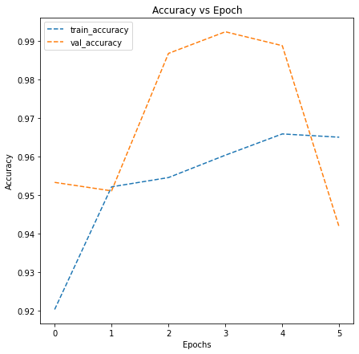
Model 4 – VGG16
Architecture
Outcomes:
The CNN used is a pretrained model that is 16 layers deep, specifically designed for classification and localization. It is a transfer learning model. The model has an accuracy of 94.9%, with a precision on average of 0.95, recall of 0.95 and an f1-score of 0.95. It is the most poor performing model, indicating that increasing number of layers may not always be beneficial at the cost of losing some needed activation functions or that transfer learning may not be able to identify features in some image sets.
Of the 1300 images of each class, 110 uninfected are classified incorrectly and 23 parasitized are classified incorrectly.
Throughout this model, the validation accuracy stays higher than the training accuracy, however as epochs increases, the validation accuracy decreases and there is no consistency in the accuracy seen. This could also be attributed to the premature interruption of the model implementation with call-backs. Potentially, early stopping may not be beneficial here. Although it is key to note the significant drop in the validation accuracy from 0.99 to 0.95 after 5 epochs. It is unknown at this time whether this downward trend would have continued since no real trend was observed for the validation data. However, this model does not appear to be robust considering these significant fluctuations in the accuracy and the much lower f1-score compared to any of the previous models.
Model Accuracy: 94.9%

